Slide 1

BOOK PROJECT
Sprint 1
Monica Lalor, Mikayla Kantorski,
Kaleigh Andrzejewski, Angela Gardner

Slide 2

PROJECT FOCUS
Create an web interface that manages a personal book library
Tracks loans made to students
Sends reminder emails

Slide 3

01
Design a website interface
02
Pick a Database
SPRINT GOALS
03
Figure out how user states correlate to database
04
Connect the database to our website

Slide 4
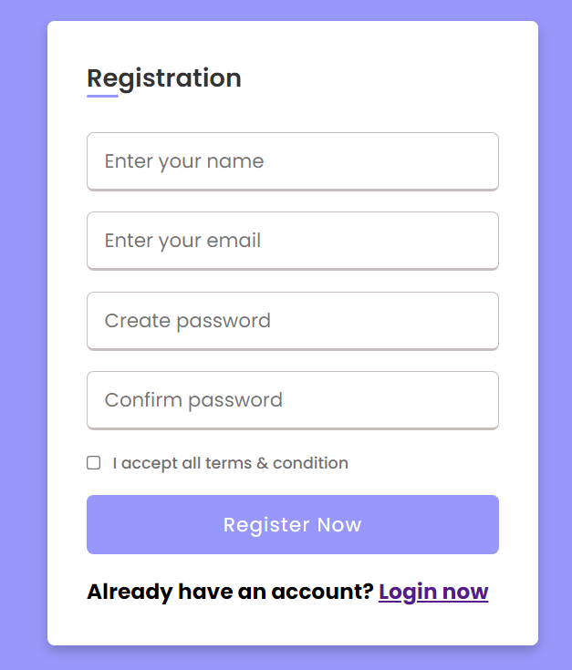
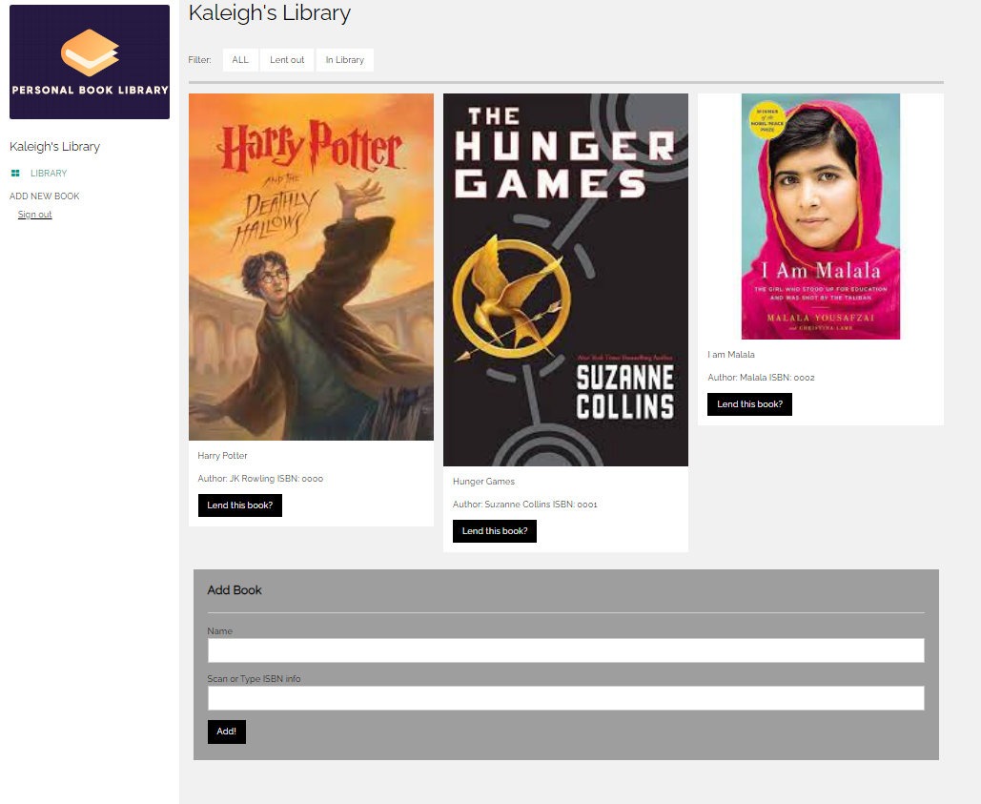
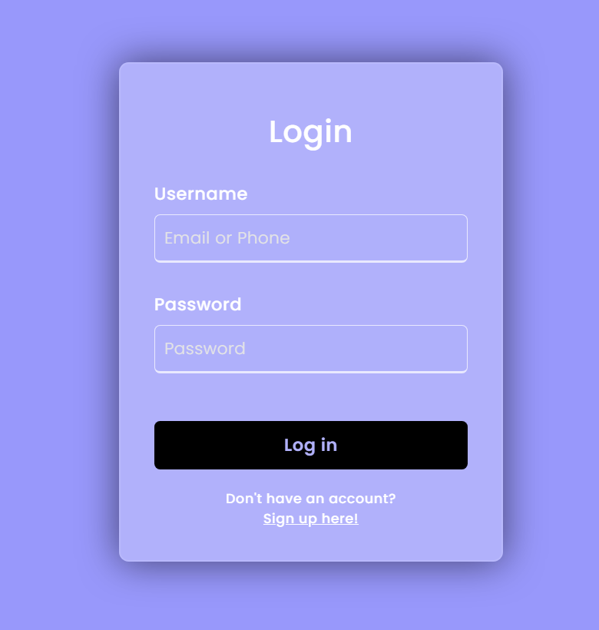

SPRINT ACHIEVEMENTS
Login
Registration
Library/Home
Database

Slide 5
BACKLOG
TO DO
IN PROGRESS
COMPLETED
Email functionality
Connect Accounts
Create & host website
Login/registration functionality
Update PWEB
Login page design
Add/edit books
Store book info in database
Registration page design
Storing books in user’s library
Home/book page design
Book scanner
Create database
Welcome/About page

Slide 6

LESSONS LEARNED
There are lots of books
To store all of the book data in our database, we need 250 GB of storage
Free databases have limited storage
Our biggest initial barrier was trying to find a database service

Slide 7


Click here
DEMO

